Slide 1


Intelligent Assignment Grading System
Agentic AI Ready Tensor Capstone with Gradio, LangGraph, LangSmith and MCP Server Integrations
Felix Elias – felixelias.com

Slide 2
The Challenge
Challenge
Manual grading of assignments requires significant effort from educators, especially when dealing with large classes or multiple sections. Each assignment must be individually reviewed, which can lead to delays in providing feedback to students. Additionally, human graders may unintentionally introduce inconsistencies due to fatigue, subjective interpretation of rubrics, or varying levels of attention. These inconsistencies can affect the fairness and reliability of the grading process, making it difficult to ensure that all students are evaluated by the same standards.
Solution
The intelligent grading system agent automates the evaluation of assignments by leveraging advanced AI models and subject-specific processors. Instead of educators manually reviewing each submission, the agentic workflow routes assignments through specialized engines that understand the nuances of different subjects (e.g., math, science, history, languages). This automation dramatically reduces the time and effort required for grading, especially in large classes or multiple sections, while maintaining high standards of accuracy and consistency.

Slide 3
Solution Overview
The Intelligent Assignment Grading System is built to deliver scalable, rubric-aligned grading by orchestrating agentic workflows, specialized processors, and flexible interfaces across diverse educational formats.
LangGraph Agentic Workflow
Specialized Processors
Multi-Format I/O
Flexible Interfaces
The system uses intelligent workflow orchestration to automatically route assignments to the most suitable evaluation pathway, balancing workloads and adapting to different formats and complexities. By leveraging subject-aware processors and AI-driven grading, it ensures consistent, accurate, and efficient management of large volumes of assignments, delivering reliable results and actionable feedback for educators and students.
Subject-aware grading engines are specialized AI modules designed to evaluate assignments with a deep understanding of the specific subject matter, whether it’s English, Mathematics, Spanish, Science, or History. Unlike generic grading systems, these engines are tailored to the unique requirements, rubrics, and evaluation criteria of each discipline.
Modern educational environments require flexibility in how assignments are submitted and evaluated. The intelligent grading system is designed to handle a wide range of file formats, ensuring accessibility and convenience for both students and educators
Formats include TXT, PDF, DOCX, MD, and images
User Interface (UI) Integration
Graphical Experience: The system offers a user-friendly graphical interface, allowing educators and administrators to interact with grading tools visually. Users can upload assignments, review grades, and access feedback through intuitive dashboards and menus.
Command-Line Interface (CLI) Integration Efficiency for Power Users: The CLI enables advanced users such as IT staff, data analysts, or instructors comfortable with command-line tools to automate grading tasks, batch process assignments, and integrate grading into custom scripts or pipelines.
MCP Integration
MCP integration allows the system to connect with educational platforms, enabling centralized control over permissions, assignment flow, and reporting. It processes structured and unstructured data using agentic workflows and subject-specific tools to deliver rubric-aligned grading, feedback, and analytics

Slide 4
High-Level System Architecture
The architecture is designed to automate and streamline the grading process for assignments using a combination of user interfaces, intelligent workflows, and specialized processing engines.
UI: A graphical dashboard for educators and administrators to upload assignments, review grades, and access feedback.
CLI: A command-line tool for power users to automate grading tasks, batch process assignments, and integrate with custom scripts.
UI / CLI
Agentic Workflow
Orchestrator
Subject Processors
Graded Outputs
Reports & Analytics
This is the core automation engine. It orchestrates the grading process by routing assignments through various steps, ensuring quality and consistency.
The workflow includes initializing the grading process, performing quality checks, classifying the subject, and selecting the appropriate processing pathway.
The orchestrator manages the flow of assignments, balancing workloads and adapting to different formats and complexities.
It ensures that each assignment is sent to the correct subject processor based on its classification.
These are specialized AI modules tailored for different subjects (i.e., English, Mathematics, Spanish, Science, or History).
Each processor applies subject-specific grading criteria, rubrics, and evaluation methods to ensure accurate and fair assessment.
After processing, the system generates graded outputs, which include scores, feedback, and analytics.
These outputs can be exported in various formats (CSV, JSON) and integrated with reporting tools.
The final stage involves compiling results into actionable reports and analytics for educators and administrators.
This helps in tracking performance, identifying trends, and ensuring transparency in grading.

Slide 5
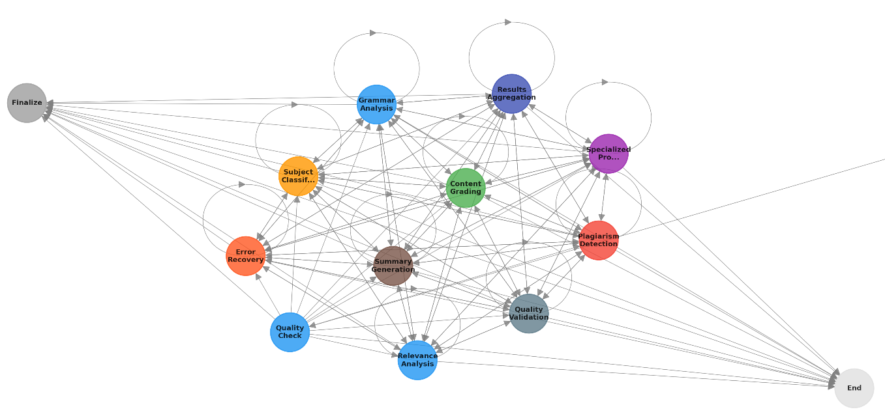
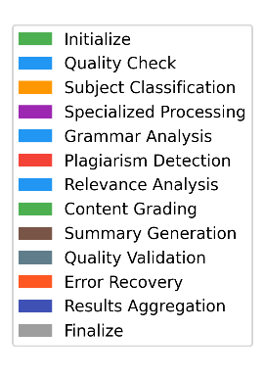
Assignment Grading Workflow
The workflow is designed to automate and streamline the evaluation of assignments using a series of intelligent steps and specialized processing modules.
Initialize
Plagiarism
Relevance
Grading
Summary
Aggregate
Quality Check
Classify Subject
Specialized Processing
Grammar
Finalize
The system begins by preparing the assignment for evaluation.
It validates the input to ensure the assignment is readable, complete, and meets basic standards.
The system uses AI to determine the subject area (i.e., English, Mathematics, Spanish, Science, or History) so it can apply the correct grading criteria.
The assignment is routed to subject-specific processors for deeper analysis. This includes:
Grammar: Checking for language and grammar accuracy.
Plagiarism: Detecting copied or unoriginal content.
Relevance: Assessing how well the response addresses the assignment prompt.
Grading: Assigning a score based on rubrics and criteria.
Summary: Generating a concise summary of the evaluation.
The system compiles results from all specialized checks.
The final grade, feedback, and analytics are produced and made available to educators and students.

Slide 6
Intelligent Subject Classification
When an assignment is submitted, the system doesn’t just treat it as generic content. Instead, it uses advanced AI models to analyze and classify the assignment based on three key dimensions:
The system automatically identifies the academic subject of the assignment such as Math, Science, History, English, or Spanish. This is crucial because each subject has its own grading standards, rubrics, and evaluation criteria.
Orchestrator
Math
Spanish
Science
History
English
Subject Detection
Beyond just the subject, the system evaluates the complexity of the assignment. For example, it distinguishes between basic arithmetic and advanced calculus in math, or between simple grammar exercises and complex essays in language assignments. This allows the system to apply the appropriate level of scrutiny and select the right grading engine.
Complexity Assessment
Approach Identification
The system also detects the type of response or methodology used in the assignment such as multiple-choice, open-ended essay, code submission, or data analysis. This ensures that the grading process is tailored to the format and expectations of the assignment.

Slide 7
Specialized Processors
Specialized AI grading engines that the Intelligent Assignment Grading System uses for different academic subjects other than English. Each processor is tailored to the unique requirements and evaluation criteria of its subject, ensuring that grading is both accurate and fair.
English
Math
Spanish
Science
History
Detects copied or unoriginal content to ensure academic integrity.
Checks for language and grammar accuracy using advanced language processing tools.
Assesses how well the response addresses the assignment prompt.
Assigns a score based on rubrics and criteria tailored to English assignments.
Generates a concise summary of the evaluation, highlighting strengths and areas for improvement.
Uses symbolic computation tools (like SymPy).
Checks if each step in a solution is correct (step verification).
Validates mathematical formulas to ensure accuracy.
Applies grammar rules using language processing tools (such as spaCy).
Evaluates vocabulary usage for appropriateness and correctness.
Considers cultural context to ensure responses are relevant and accurate for the language
Assesses the accuracy of scientific concepts.
Reviews the methodology used in experiments or explanations.
Interprets data to check if conclusions are valid.
Checks facts to ensure historical accuracy.
Analyzes sources for credibility and relevance.
Evaluates the strength of arguments presented in essays or responses.
By using subject-specific processors, the system can:
Apply the right grading standards for each discipline. Provide more meaningful, targeted feedback to students. Reduce grading errors that might occur if a generic system were used for all subjects.

Slide 8

Inputs & Extraction
The Intelligent Assignment Grading System uses specialized AI grading engines for diverse assignment formats. Each processor is tailored to the unique requirements and evaluation criteria of its input type, ensuring that grading is both accurate and fair.
Supported Formats
The Intelligent Assignment Grading System supports multiple formats:
Text files: TXT, MD Documents:
PDF, DOCX
Images: via OCR (Optical Character Recognition)
This flexibility ensures that assignments in various formats can be seamlessly processed and graded, making the system accessible and convenient for both educators and students.
Smart Processing
This intelligent processing streamlines the grading workflow, reduces manual effort, and helps maintain high standards of accuracy and fairness.
Automatic format detection: Instantly recognizes the type of assignment file for seamless intake and grading.
Metadata extraction: Captures key details such as author, submission date, and assignment type to support tracking and reporting
Quality validation & handling: Ensures each assignment is readable, complete, and meets basic standards before grading begins.
Current Reporting: Grading results and analytics are exported to CSV files, allowing educators to review grades, feedback, and performance summaries in a structured format. Additional reporting is available via LangSmith Integration.
Future Expansion: The system could be enhanced with a business intelligence (BI) reporting layer, enabling advanced analytics and interactive visual dashboards for deeper insights into grading trends and student performance.

Slide 9
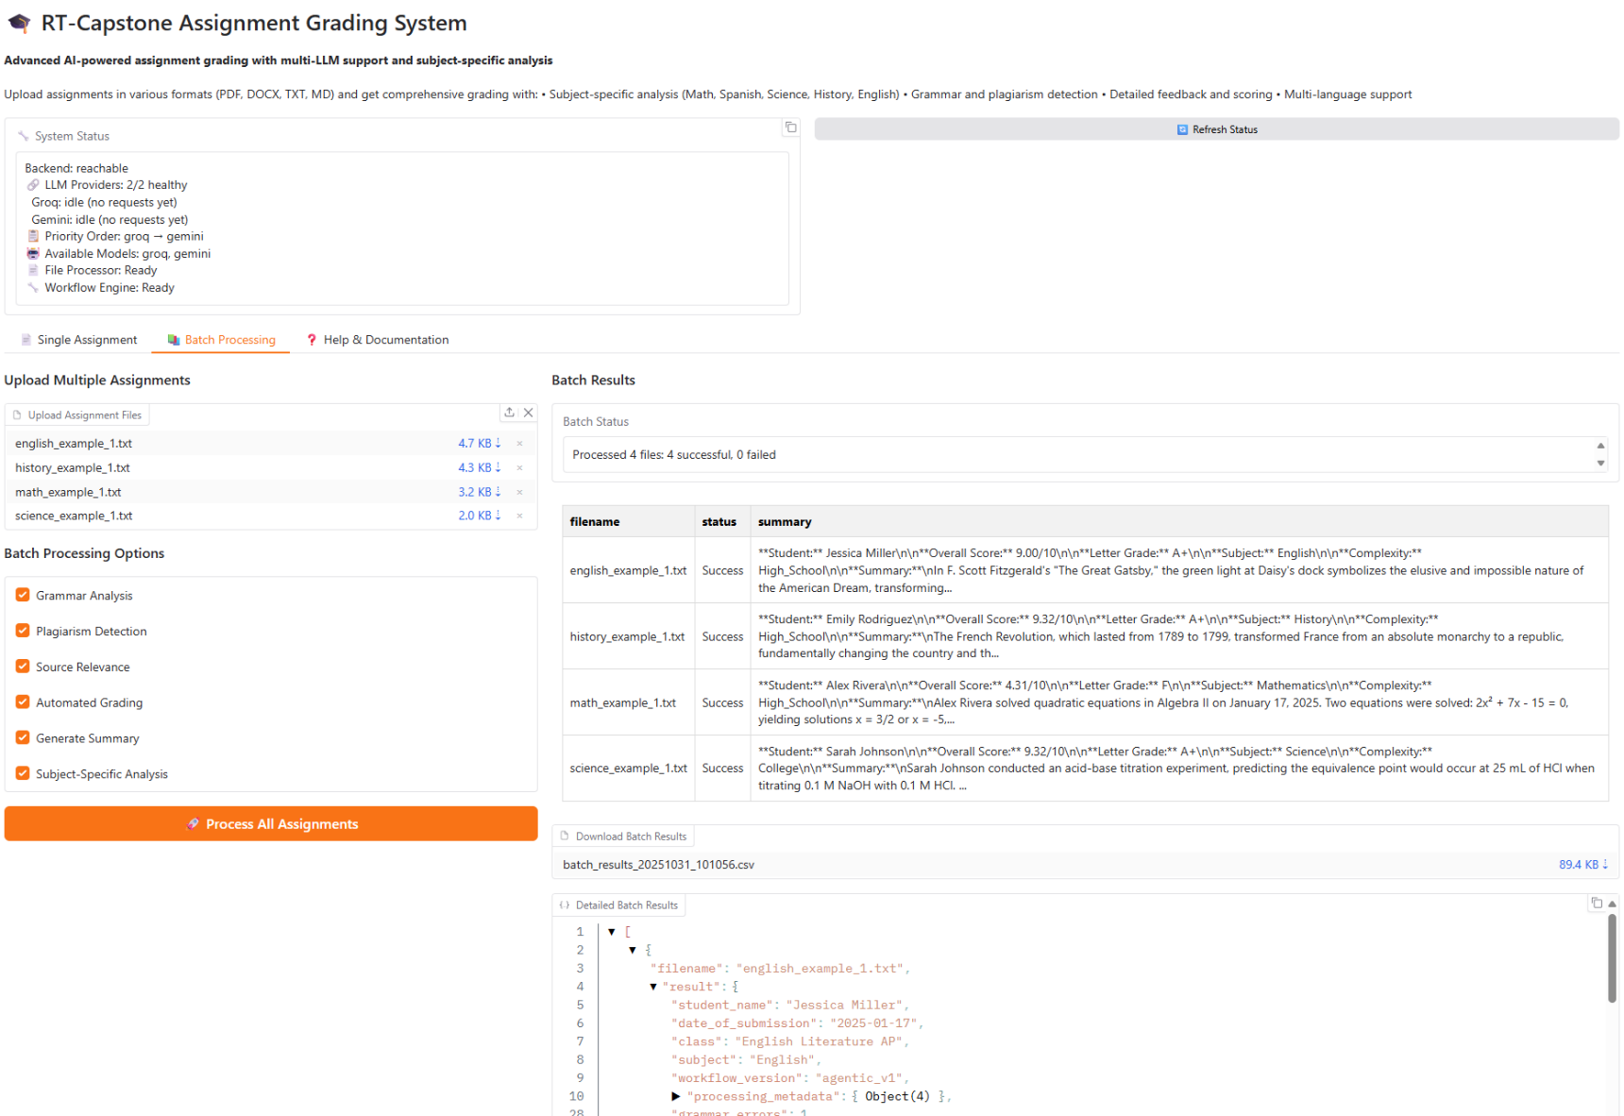
Demo: Gradio UI
Each Gradio feature is specifically designed to meet the distinct needs of grading workflows, making assignment processing both streamlined and transparent for educators and students.
Features
Single Assignment Grading
Grade individual assignments with precision. Educators can upload a single file and receive instant, detailed feedback and scoring, ensuring each student’s work is evaluated thoroughly and fairly.
Batch Processing Mode
Efficiently handle large volumes of submissions. The system allows educators to upload multiple assignments at once, automating the grading process and dramatically reducing turnaround time for entire classes or sections.
Live Status Updates
Stay informed throughout the grading workflow. Real-time progress indicators show which assignments are being processed, graded, or completed, providing transparency and peace of mind for educators and administrators.
JSON Detail Viewer
Access in-depth grading analytics. The system presents detailed grading breakdowns in JSON format, allowing users to review scores, feedback, and evaluation criteria for each assignment in a structured, easy-to-understand way.
Export & Download
Seamlessly export results for reporting and record-keeping. Educators can download grades, feedback, and analytics in various formats (CSV, JSON), making it easy to share results, analyze performance, and integrate with other educational tools.

Slide 10
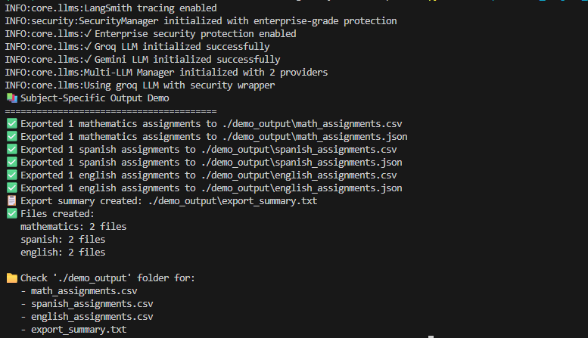
Demo: CLI Mode
The CLI option is designed to meet the needs of advanced users and power educators. It enables efficient automation, batch processing, and integration with custom workflows, ensuring that assignment grading is both scalable and adaptable to diverse educational environments. Each CLI feature is tailored to streamline grading tasks, making the process faster and more flexible for users who require robust control and customization.
Available Modes
Invoke-RestMethod -Uri http://127.0.0.1:8000/process_file -Method Post -Form @{ file=Get-Item $file; requirements=$req }
Agentic: Full workflow execution
Runs the complete intelligent grading workflow from start to finish. Assignments are automatically classified, routed through subject-specific processors, and evaluated using all available checks (grammar, plagiarism, relevance, grading, summary). This mode is ideal for comprehensive, automated grading at scale.
Auto: Simplified processing
Executes a streamlined version of the grading workflow, focusing on essential evaluation steps for faster results. Useful for quick grading tasks or when only basic feedback is needed.
Demo: Workflow visualization
Provides a visual representation of the grading workflow, showing how assignments move through each processing stage. This mode is perfect for demonstrations, training, or understanding the system’s internal logic without performing actual grading.
MCP: Integration server
Connects the grading system to external educational platforms via the MCP server. Enables centralized control over assignment flow, permissions, and reporting, and allows integration with other tools and data sources for enhanced automation and analytics.

Slide 11
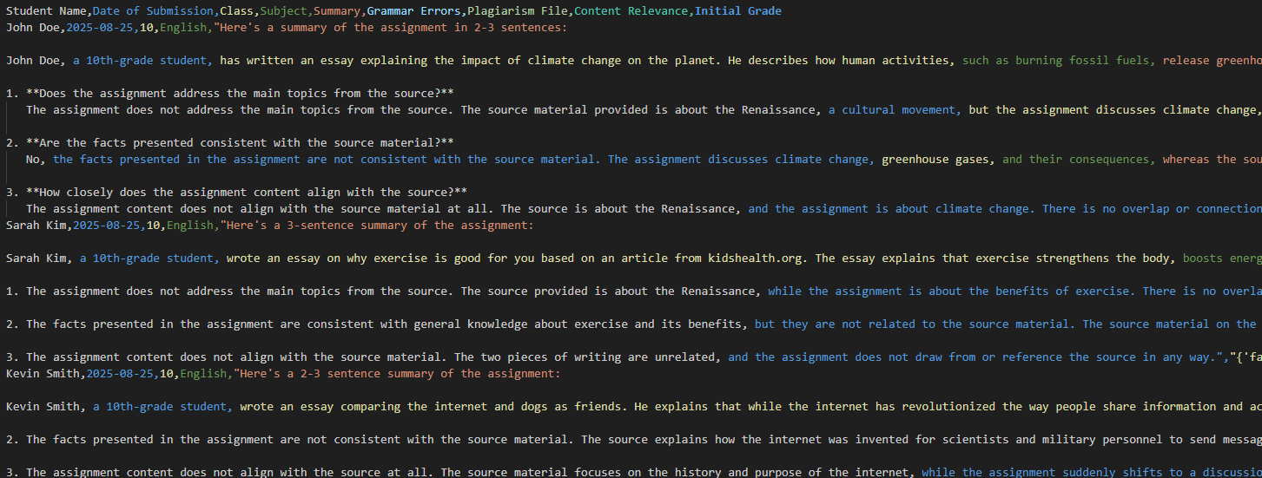
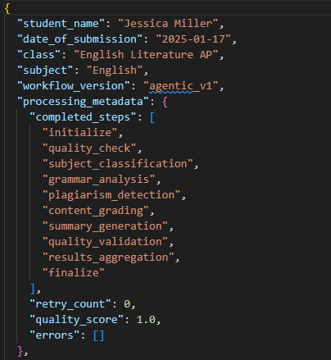
Outputs & Exports
The Output and export feature is tailored to the unique requirements of grading workflows, ensuring that results are both accessible and actionable for educators and students.
Export Formats
output/summary.csv
Summary CSV Reports
The system generates summary CSV reports that provide an overview of grading results for all processed assignments. These reports include essential details such as file name, subject, grade, and status (e.g., Pass/Fail), allowing educators to quickly review overall performance and identify trends across classes or sections.
Subject-Specific CSV/JSON
For deeper insights, the system produces subject-specific reports in both CSV and JSON formats. These detailed exports break down grading criteria for each subject (such as grammar, relevance, and feedback for English assignments), enabling educators to analyze performance by discipline and tailor feedback to individual student needs.
Detailed Plagiarism Reports
Plagiarism detection is integrated into the grading workflow, and the system generates comprehensive reports highlighting any instances of copied or unoriginal content. These reports help maintain academic integrity by providing transparency and actionable information for both educators and students.
Grading Breakdown Analytics
Advanced analytics are available to visualize and interpret grading results. The system offers breakdowns of scores by rubric criteria, feedback summaries, and performance analytics, empowering educators to make data-driven decisions, identify areas for improvement, and ensure fairness in evaluation.
output/english.json
{"{"} "grammar": 90,
"relevance": 85,
"feedback": "..." {"}"}

Slide 12
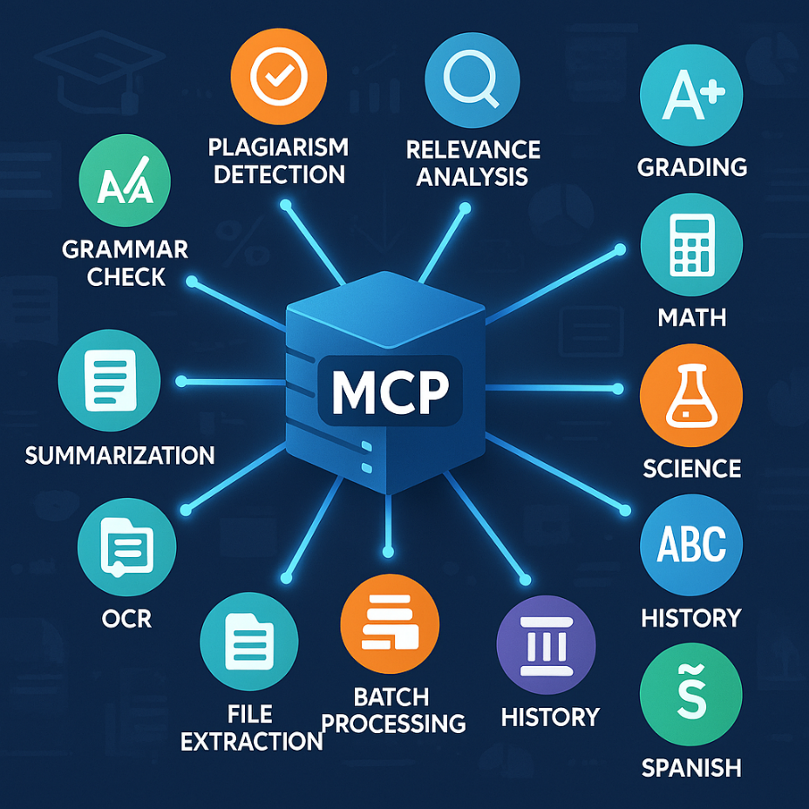
MCP Integration
Each MCP integration feature is purpose-built to address the specific needs of educational platforms, providing centralized management, smooth assignment handling, and comprehensive reporting.
MCP Integration: Exposed Tools Overview
The MCP server exposes a suite of specialized tools for assignment grading and analysis, each designed to automate and streamline key evaluation tasks:
Core Analysis Tools:
Grammar Check: Analyzes grammar using LanguageTool.
Plagiarism Check: Detects copied content and generates reports.
Relevance Check: Assesses how well responses match the assignment prompt.
Grade Assignment: Scores assignments on multiple criteria (factuality, relevance, coherence, grammar).
Summarize Assignment: Produces concise summaries of student work.
Parallel & Agentic Workflows:
Parallel Processing: Runs grammar, plagiarism, relevance, grading, and summary checks concurrently for speed.
Agentic Workflow: Uses LangGraph for comprehensive, subject-aware grading.
File & Batch Processing:
File Extraction: Processes and validates assignment files in various formats.
Batch Processing: Grades multiple files safely and efficiently.
OCR & Scanned Content:
OCR Tools: Extract text from scanned PDFs and images, supporting handwritten and printed assignments.
Language & Subject-Specific Utilities:
Multilingual Support: Detects language and grades assignments in English, Spanish, Math, Science, and History, using tailored processors for each subject.
Orchestrator & Routing:
Intelligent Classification: Automatically identifies subject, complexity, and approach for each assignment, routing it to the appropriate processor.
Export & Reporting:
Subject-Specific Exports: Generates CSV/JSON reports for English, Math, Science, Spanish, and History assignments.

Slide 13
Security & Reliability
Security and reliability measures specifically designed for educational platforms, delivering multi-layered protection, secure processing, and resilient error recovery to keep grading workflows safe and dependable for both educators and students.
Security
Secure execution wrapper: All grading operations are performed within a secure execution environment, protecting sensitive student data and preventing unauthorized access. This wrapper ensures that only validated processes can interact with assignment files and grading tools.
Input validation & sanitization: Every assignment file and user input is rigorously checked for completeness, correctness, and safety. The system sanitizes inputs to block malicious content, prevent injection attacks, and guarantee that only clean, readable data enters the grading workflow.
Rate limiting protection: The system enforces strict limits on the number of grading requests per user or per time period. This prevents abuse, protects against denial-of-service attacks, and ensures fair access for all educators and students.
Comprehensive logging: Every action, grading event, and system interaction is logged in detail. These logs support auditing, troubleshooting, and compliance, helping administrators monitor system health and investigate any issues or anomalies.
Multi-Layer Protection
Security Wrapper
Validation Layer
Core System
Reliability
Multi-LLM Fallback System: The grading system is designed to use multiple large language models (LLMs) in parallel or as backups. If the primary model encounters an error or becomes unavailable, the system automatically switches to an alternative LLM, ensuring uninterrupted grading and consistent results.
Error Recovery Mechanisms: Robust error handling is built into every step of the grading workflow. If a process fails or encounters unexpected input, the system can recover gracefully by logging the issue, retrying the operation, or alerting administrators as needed. This minimizes disruptions and helps maintain workflow stability.
Quality Validation Checks: Before finalizing any grading output, the system performs thorough quality checks to verify accuracy, completeness, and adherence to grading standards. These checks help catch anomalies, prevent errors from propagating, and ensure that only high-quality results are delivered.
Automated Retries: If a grading step fails due to a temporary issue (such as a network glitch or model timeout), the system automatically retries the operation. This increases reliability and reduces the likelihood of incomplete or missing results.

Slide 14
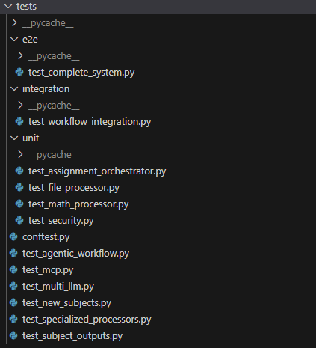
Robust Testing
Pytest enables fast, reliable, and scalable testing for Python code, making it easy to validate functionality and ensure robust performance. Its simple syntax and powerful features streamline both unit and integration testing for development teams.
Testing
The system uses a comprehensive suite of tests to ensure reliability and correctness:
End-to-End (e2e) Tests:
Validate the complete system workflow, including assignment orchestration and file processing.
Integration Tests:
Check how different modules interact, such as workflow integration and security features.
Unit Tests:
Improved monitoring and debugging capabilities help teams quickly identify issues and optimize AI application performance.
Focus on individual components, including:
Assignment orchestrator
File processor
Math processor
Security features
Agentic workflow
Multi-LLM fallback
Specialized subject processors
Subject-specific outputs
Benefits of Testing with Pystest:
Testing with Pytest offers significant advantages for the Intelligent Assignment Grading System. Its fast and reliable execution allows developers to quickly identify and resolve issues, ensuring robust performance across all system components. Pytest’s scalable framework supports large and complex test suites, making it ideal for validating workflows in educational environments. The simple and intuitive syntax streamlines the process of writing and maintaining tests, while powerful features such as fixtures and parameterization enable thorough unit and integration testing. By facilitating continuous validation and integration, Pytest helps maintain code quality and stability, ensuring that new updates do not disrupt existing functionality.

Slide 15
Seamless LangSmith Integration
LangSmith integration enables efficient tracking, monitoring, and optimization of AI-powered grading workflows, delivering deeper insights and continuous improvement for educators and developers.
LangSmith Benefits
Execution Tracking
Trace and Logging
Efficient Interaction Tracking:
LangSmith makes it easy to efficiently track and analyze interactions between language models and users for deeper insights.
Streamlined Workflow Integration:
By connecting models and data sources, LangSmith streamlines workflows and enhances system efficiency across projects.
Advanced Monitoring and Debugging:
Improved monitoring and debugging capabilities help teams quickly identify issues and optimize AI application performance.
Continuous Optimization and Evaluation:
With robust logging and evaluation tools, LangSmith empowers continuous testing and improvement of AI applications.
Auditability and Compliance:
LangSmith’s detailed interaction logs support audit trails, making it easier to demonstrate compliance with educational standards and data privacy regulations.
Collaboration and Sharing:
Teams can share interaction traces and debugging sessions, improving collaboration and accelerating development cycles for AI-powered educational tools.
Custom Evaluation Metrics:
LangSmith allows the creation and tracking of custom evaluation metrics, enabling educators and developers to tailor performance assessments to specific learning objectives.
Scalability:
The platform supports large-scale deployments, making it suitable for institutions with thousands of students and complex grading workflows.
User Experience Insights:
By analyzing user interactions, LangSmith helps identify patterns and areas for improvement, leading to a better experience for both educators and students.

Slide 16
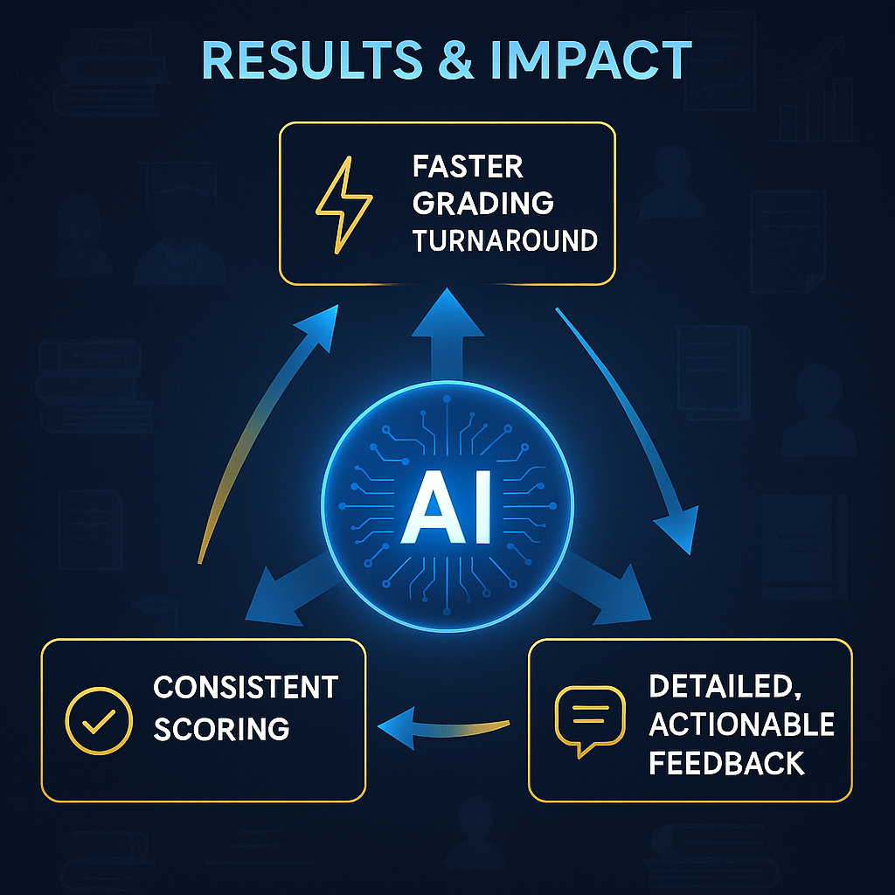
Outcome
Speed up grading, promote fairness, and give students meaningful feedback by providing consistent results and rapid insights through intelligent automation.
Results & Impact
Faster Grading Turnaround:
What it means: Assignments are graded much more quickly than traditional manual methods.
How it works: The system automates the entire grading workflow, from input validation to subject classification and rubric-based scoring. Batch processing and parallel workflows allow large volumes of assignments to be evaluated simultaneously, dramatically reducing turnaround time for educators and students.
Impact: Students receive feedback sooner, enabling them to learn and improve more rapidly. Educators spend less time on repetitive grading tasks and more time on teaching and student support.
Consistent Scoring:
What it means: Every assignment is evaluated using the same standards and criteria, regardless of who submitted it or when.
How it works: The system uses subject-aware AI processors and standardized rubrics to ensure that grading is fair and reliable. Automated quality checks and multi-LLM fallback mechanisms further reduce human error and bias, maintaining consistency across all submissions.
Impact: Students are graded equitably, and educators can trust that scores reflect true performance. This consistency also helps identify trends and areas for improvement across classes or sections.
Detailed, Actionable Feedback:
What it means: Students and educators receive in-depth feedback that goes beyond just a score.
How it works: The system generates comprehensive grading breakdowns, including strengths, areas for improvement, and specific comments aligned with rubric criteria. Feedback is available in structured formats (CSV, JSON) and can be exported for further analysis or integration with other educational tools.
Impact: Students understand exactly how they performed and what they can do to improve. Educators gain insights into class performance and can tailor instruction to address common challenges.

Slide 17
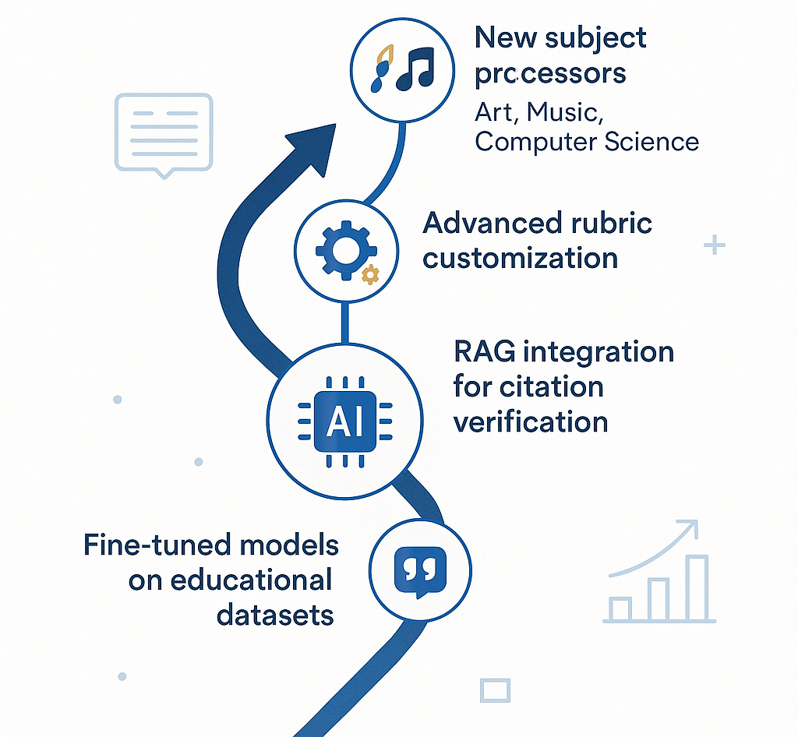
Future Roadmap
Future Enhancements
Additional subject processors (Art, Music, Computer Science)
Advanced rubric customization engine
RAG integration for citation verification
Fine-tuned models on educational datasets
Questions?
If you have any questions, contact me at felixelias.com or via email at felixelias5@gmail.com
Repository & Documentation Available in my Github repository:
https://github.com/felixchess5/Intelligent-Assignment-Grading-System

